Slide 1

bPlus Line
Greifensee
June 2016
Small Details. Big Difference.

Slide 2
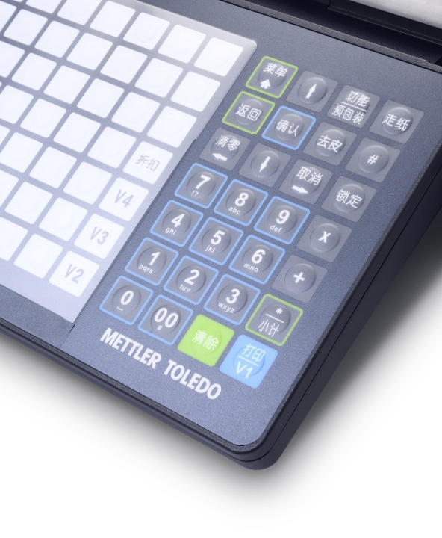
Easy Operation
Familiar daily operation further enriched for even more operator efficiency
  Optimized for quick and easy operation
  Accelerate sales and prepack workflows
  Convenient changeover from serving to pre-packaging
  User-compatible to previous models
  Logical menu structure simplifies navigation
  Quick response keyboard
    Pressure sensitive keys for faster operation
  Ergonomic design
  Straightforward keyboard customization
    Clever key mapping
    70 preset keys per layer (total 140)
    Additional configurable function keys
  Convenient Network / Communication status icon
Notes:
Andre added clever key mapping ( after trying it out I liked it and thought it must be mentioned ☺)

Slide 3
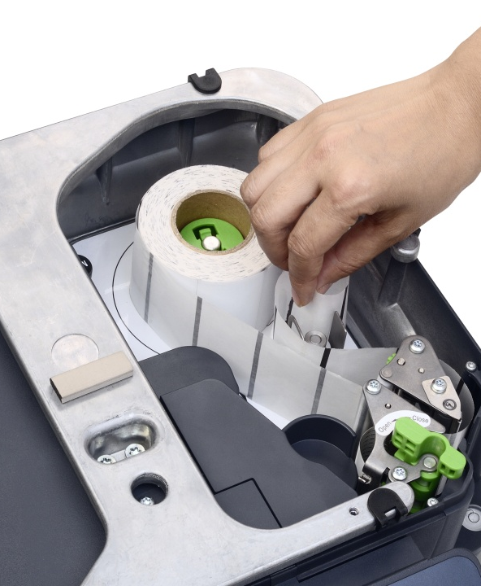
Easy Operation
Easy-to-learn operation helps minimize training efforts
  Advanced printing with reliable label delivery
  Practical printer clamp mechanism
  Innovative paper guide
  Useful spare paper-core storage
  Long lifespan print head technology
  Fast, high quality thermal printing (125mm/s, 203dpi)
  Automatically identify loaded label size
  Reduce label size, simplify scanning and optimize print head life
  Vertical barcode , small barcode, edge - edge / top - bottom
  Quick acess to printer from the top for effortless paper replacement and cleaning
  Less counter space required (no drawer)
  Convenient plate storage
  Short paper-feed path
Supports label rolls <120mm in diameter – less rolls changes are needed
2
1
3
Notes:
Tony:
Check feature automatiacally identify loaded label size: gap between labels or size and which size and how to trigger?
Check edge to edge and top to bottome printing

Slide 4
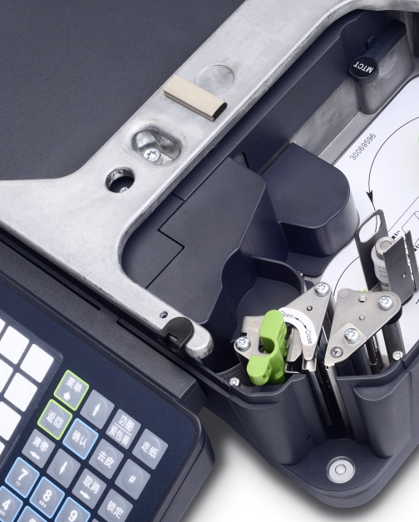
Lasting Investment
Reduce daily running costs while keeping future needs in mind
  Generous memory capacity (32 MB)
  Energy saving
  Less than 0,5 w power consumption
  Standy by mode
  Mixed installation with previous generation scales possible
  Reduce maintenance cost
  Modular, individual electronic boards
  Quick access from the top to all components
  No need for recalibration when replacing electronics (except AD board)
  Flexible hardware design for future extension (e.g. upgrade to linerless without replacing complete printer)

Slide 5
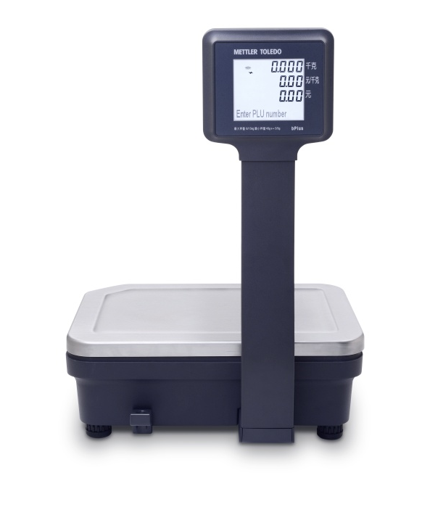
Quality
Built to withstand the demanding retail environment and still look good
  Stylish design to complement store decor
  Insect proof housing
  Robust construction
  Heavy-duty cast aluminium
  Impact and scratch resistant surfaces
  Two independant printer motors, - 90% metal parts
  Hygienic Stainless steel weighing platter
    Food grade, rust-proof, strong-torsion
  Easy to clean
  Anti-stick surface
  No sharp corners or edges
  Interfaces placed on bottom of scale, protected against dirt, moisture and damage
  Clear and easy to read backlight display
  Industrial-grade electronic components
  Accurate, quick, weight stabilization
  Overload protection < 400% of max capacity

Slide 6
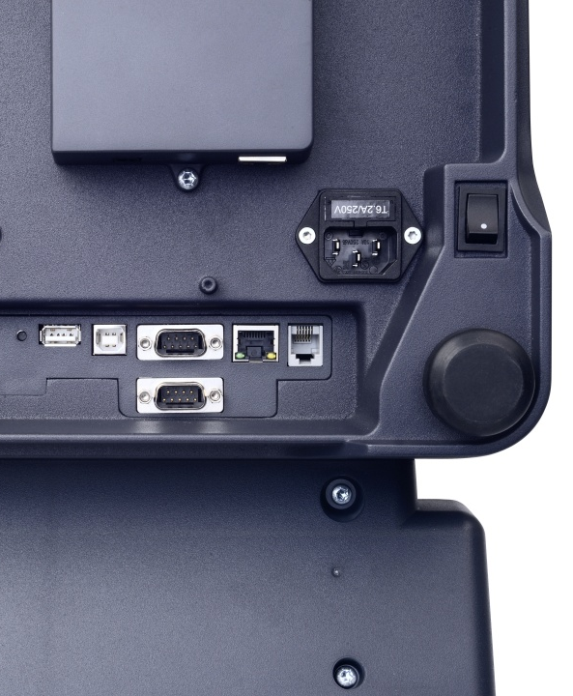
Smart Scale Management
Proven scale application that continues to adapt to your diverse needs
  Feature-rich application software
  Many years of customer requirements
  Counter sales and prepacking
  QR-code, basket total, transaction log, fast price changes, online price update, floating vendor
  Regulation compliance (e.g. traceability)
  Convenient setup and configuration
  Scale configuration software (PC tool)
  USB Mass Storage
    Simple data transfer from scale/scale
    Update item data
    Copy scale configuration
    Update firmware
    Backup/restore scale data
  Comprehensive network communication
  Stable, secure WLAN (optional): infrastructure or adhoc (device to device)
  DHCP for automatic IP setup

Slide 7
The bPlus in a nutshell
Smart. Proven. Future-proof – the next generation Label Printing Scales
Ergonomic and stylish design
Clear & easy to read backlight display
Robust & hygienic construction
Feature-rich application SW
Easy keyboard customization
Backward compatibility
Quick response keyboard
DHCP, Adhoc WLAN device to device
Anti-stick surface
USB for data transfer, upgrades, backup and restore
Insect proof housing
Serviceability from the top
32 MB memory
Easy Paper loading
Less stand-by power
Advanced printing
Wireless and Linerless (optional)
Reliable label delivery
Industrial-grade Components
Vertical barcode and small labels

Slide 8
Technical Information
Engineered to provide you with outstanding benefits
Models & Capacities
Display*
Communication
3/6kg dual range
6/15kg dual range
15/30kg dual range
Segment with orange backlight
One line dot matrix with orange backlight
One line dot matrix with white backlight
10/100 Base T Ethernet, TCP/IP, USB
DHCP support: automated network setup
Adhoc
Printer*
Reports
Interfaces
Thermal printer, resol. 203 dpi
Labels/Tickets, upgradeable to Linerless
125mm/sec (max.)
Roll diameter 120mm
Total sales reports
PLU reports
Group reports / Vendor reports
Daily, weekly, monthly, yearly
2xRS232
1xEthernet
2xUSB
1xCash box
Keyboard
Power and Data Storage
Accessories*
70 preset keys with two layers for assigning 140 PLUs
Preset Function Keys
100~240VAC, 50/60Hz, 1.6 A
Standby Power Consum. < 0.5W
Working Power efficiency > 85%
32 MB internal memory
Power cord
Tower kits
Wireless kit
* Regional offering
Notes:
Adhoc
Write more reports
Check printer resolution

Slide 9

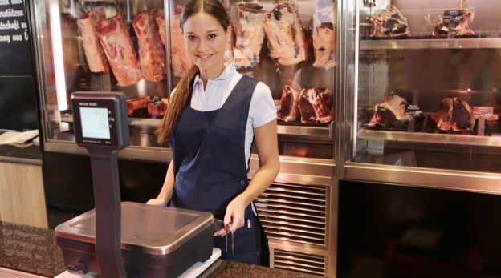

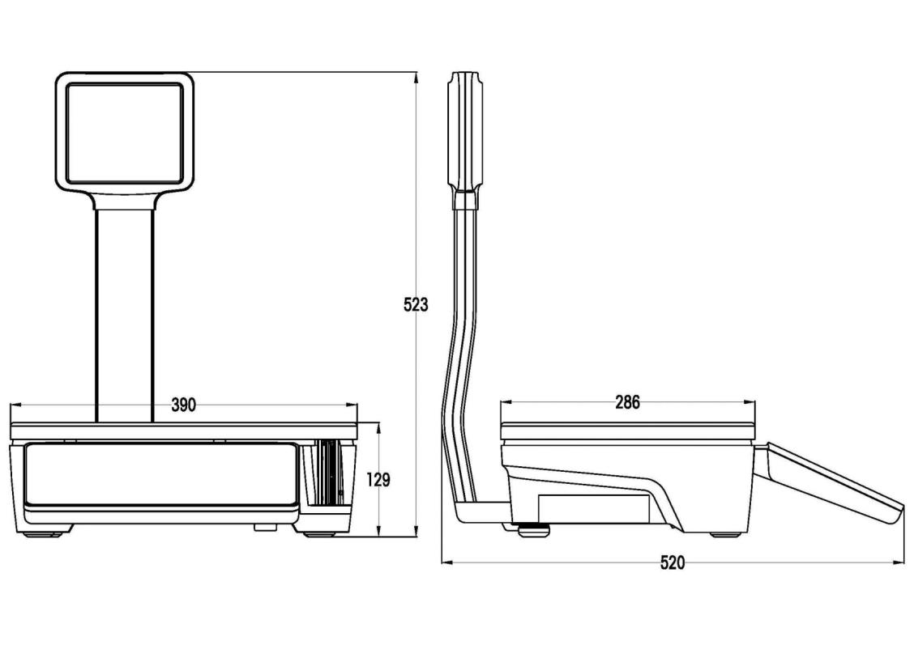
Dimensions
The bPlus is designed for various working areas
Net Weight
Gross Weight
Shipping Dimensions in mm

